Slide 1

EtherCAT Communication with applications to force sensor feedback
Summer 2023 – Larissa Jin

Slide 2

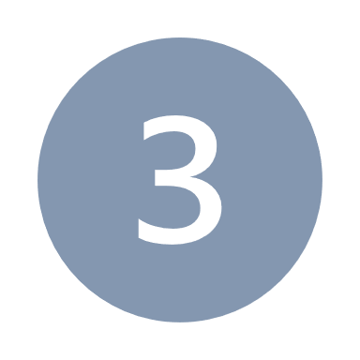

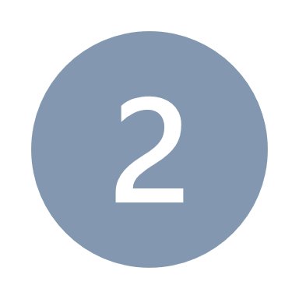
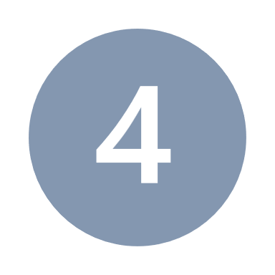

Overview
Application for EtherCAT
Results
EtherCAT vs Ethernet
EtherCAT setup
Force Sensor Feedback
Future Work

Slide 3
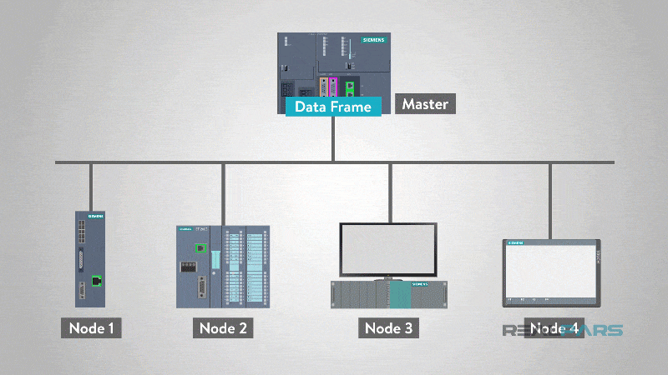
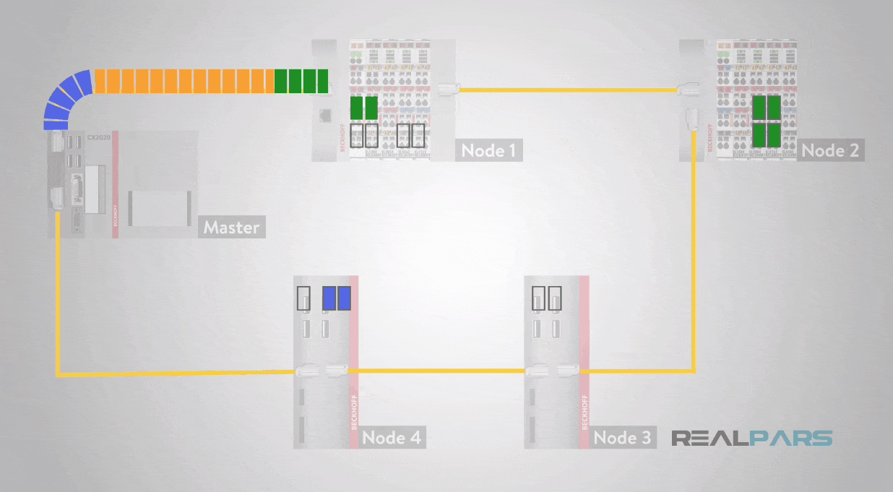
EtherNET/IP
EtherCAT
[1]
[1]
Notes:
Can only send or receive based on request
Can send and receive simultaneously
Ethernet processes all data frames no matter if it is for the node or not
EtherCAT only processes data for each node
Ethernet/IP: Master would send a command and node would send back a confirmation that the information has been received
EtherCAT: processes data on the fly

Slide 4


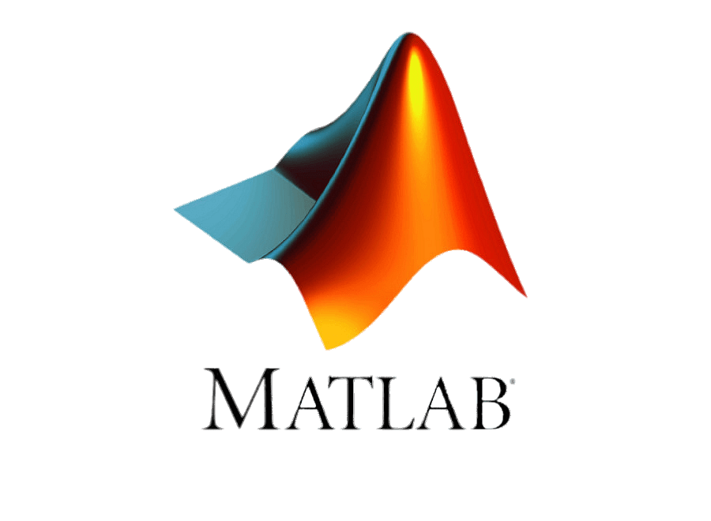

EtherCAT Setup
EtherCAT device
Computer

Slide 5
EtherCAT workflow
EtherCAT Communication
ADS Communication
EtherCAT device
EtherCAT Master
Computations

Slide 6
Application for EtherCAT
Implement BOTA force sensor with MECA500 for a faster force feedback control for ultrasound automation controlling z-axis linear motion and rotational motion about x axis
Translation along z-axis
Rotation about x-axis
z
z
x
y
x
y
1.
2.

Slide 7
Method
Read force data
Use a PID controller to correct z position and angle to ensure a z-force is maintained and probe is perpendicular to the surface
Send corrected position to MECA500

Slide 8
Problems
Solutions
Calculate offset values that will maintain probe position and account for it in the position of robot end effector
Account for force sensor miscalibration by creating a plot of orientation and measured force and then fitting a plot of best fit
Rotation about x-axis of probe is different than rotating robot end effector about its center axis
When the force sensor rotates it causes internal forces in the force sensor resulting in the measured value deferring from the true value
y
z
force
angle

Slide 9
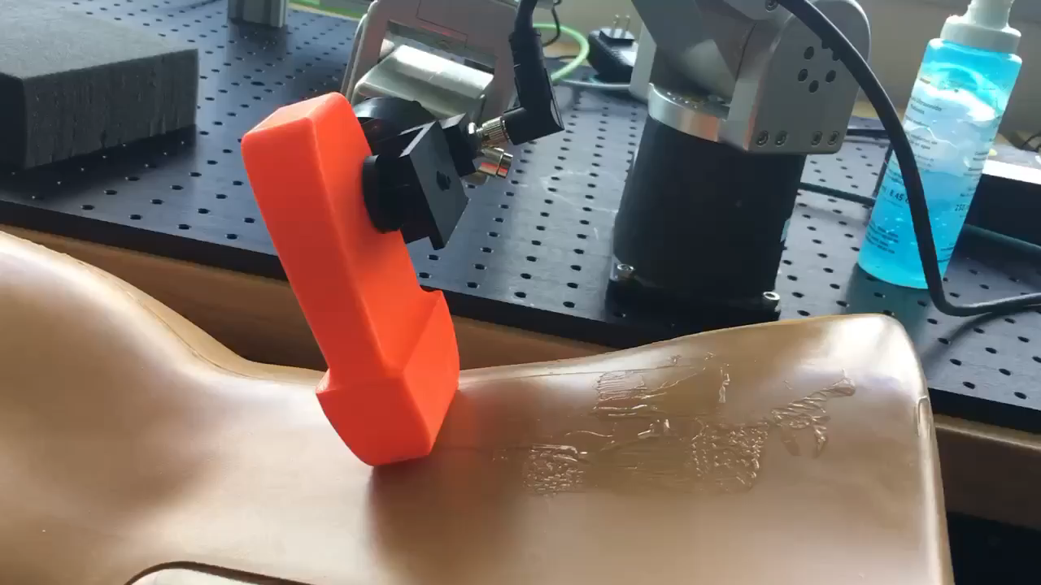
Results

Slide 10
Future Work
Improve speed of the loop by improving controller
Add in a control for rotation about the y axis (pitch)

Slide 11
Citations
[1] “What is EtherCAT”. RealPars. [Online] https://realpars.com/ethercat/#:~:text=Eth ernet's%20star%20topology%20is%20si mple,flexibility%20for%20your%20Ether CAT%20network.

